Slide 1

Nailing the Interview
Kristi Mills-Jurach, P.E.
Assistant Director, Office of Compliance and Enforcement
Texas Commission on Environmental Quality

Slide 2

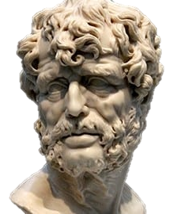
Luck is what happens when preparation meets opportunity.
Seneca the Younger
Roman philosopher

Slide 3
1
How to nail the interview in three simple steps
2
3

Slide 4
1
Be ready

Slide 5
Tell your story
2

Slide 6
Follow through
3

Slide 7

Caveats
You want the job
You are qualified for the job

Slide 8
Be ready

Slide 9

Inventory your life and work experiences
Kristi’s Personal Book of
What have you done that you are proud of?
What has gone wrong and what did you learn?
What is your greatest triumph?
What is your biggest defeat?
What made you the person you are today?
Greatness

Slide 10
S
Situation
T
Task
A
Action
R
Result

Slide 11

Practice Exercise
Tell me about a time you had to buy a gift for a special person.

Slide 12
Review your accomplishments
Assign positive character traits to each accomplishment
https://www.monster.ca/career-advice/article/50-personality-traits-for-the-workplace-canada
Kristi’s favorites
Ambitious
Creative
Curious
Determined
Flexible Focused
Honest
Insightful
Intuitive
Organized
Resourceful Responsible

Slide 13

Read the job description or posting
General Description
Essential Functions
Minimum Qualifications
Preferred Qualifications
Knowledge, Skills, and Abilities
This is how you get the interview

Slide 14
You can (and probably should) revise your application and/or resume to fit the job description

Slide 15
The night before your interview, read your accomplishments
Kristi’s Personal Book of
Greatness
Notes:
Keeps it fresh in your mind
Allows you to select the skills you’d like to highlight
Makes you feel good

Slide 16
Tell your story

Slide 17
Every question is intended to inform the interviewer about your possession of a certain skill, experience, or attribute.
skill
experience
attribute

Slide 18
Three major types of questions:
Experience – “Tell me about a time you…”
Attributes – “What are your strengths…”
Predictive – “What would you do if…”

Slide 19

Formulate your response
Consider what skill, experience or attribute is being tested
Identify an experience that demonstrates you have that
Answer the question and provide an example

Slide 20
Example: Tell me about a time you took the lead to solve a problem
Okay answer:
I helped my team adopt the new CAPPS financial system.

Slide 21
Example: Tell me about a time you took the lead to solve a problem
Better answer:
S: I was a purchaser when my agency adopted the new CAPPS financial system. This was completely new for my whole team.
T: I was tasked with leading implementation for my team.
A: I created a new standard operating procedure (SOP) for our team that could be used as a reference for experienced staff as well as a training guide for new staff.
R: Our team was able to transition to CAPPS with fewer issues than other teams.

Slide 22
Example: What is your greatest strength?
Okay answer:
I am very knowledge in my job and can adapt when things change.

Slide 23
Example: What is your greatest strength?
Better answer:
I can identify and put in solutions that benefit my whole group.
For example…
S: I was a purchaser when my agency adopted the new CAPPS financial system. This was completely new for my whole team.
T: I was tasked with leading implementation for my team.
A: I created a new standard operating procedure (SOP) for our team that could be used as a reference for experienced staff as well as a training guide for new staff.
R: Our team was able to transition to CAPPS with fewer issues than other teams.

Slide 24
Example: What would you do if your team was forced to change their processes?
Okay answer:
I would help my team understand the new challenges and put systems in place.

Slide 25
Example: What would you do if your team was forced to change their processes?
Better answer:
I would identify and put in systems that would benefit my whole group.
For example….
S: I was a purchaser when my agency adopted the new CAPPS financial system. This was completely new for my whole team.
T: I was tasked with leading implementation for my team.
A: I created a new standard operating procedure (SOP) for our team that could be used as a reference for experienced staff as well as a training guide for new staff.
R: Our team was able to transition to CAPPS with fewer issues than other teams.

Slide 26
Follow through

Slide 27


Congrats! You got the job!
Celebrate!!
Aspire to live up the attributes you displayed on the interview
Look to add value every day
Do more than is asked, without being asked

Slide 28
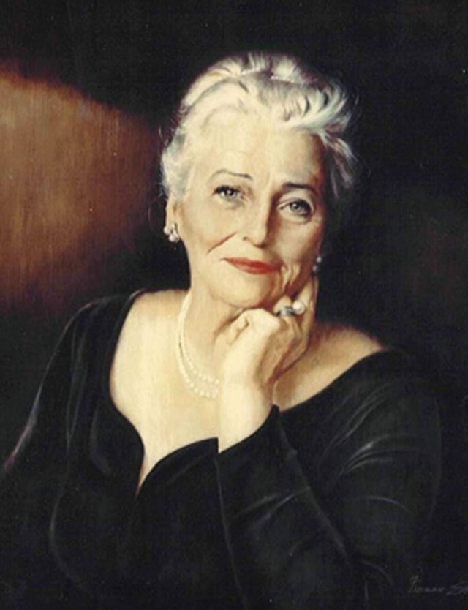
Keep being ready
Learn something new
Strive for work-life balance
Challenge yourself
Take some risks
Find a mentor
Be a mentor
The secret of joy in work is contained in one word—excellence. To know how to do something well is to enjoy it.
Pearl S. Buck
American Novelist and Nobel Prize Winner

Slide 29
Special Cases

Slide 30

You are over-qualified
I’m not a short-timer!!
Address the elephant in the room
Commit to staying a reasonable amount of time
Commit to bringing more value
  Train replacement
  Develop systems
Be honest about your long range
plans and how this job fits in
with them
Be prepared to love the job
Notes:
If you can’t do these things, you probably shouldn’t be trying to get this job

Slide 31

You are making a career change
Embrace it and share your long-range plans
Talk about your aspirations with excitement
Focus on transferrable skills
  Marketing -> Creating reports, analyzing data
  Supervising -> Training
  Lab tech -> Inspecting, investigating
Acknowledge your inexperience as an opportunity to learn
Emphasize “fresh perspective”

Slide 32
Jobs are changing, so can you
Dream Jobs – Gen X
(ages 7-11)
Dream Jobs – Gen Z
(ages 7-11)
Teacher
Vet
Doctor
Athlete
Nurse
Scientist
Sports person
Teacher
YouTuber or influencer
Artist
Vet
Gamer
Doctor
YouTuber or influencer
Nurse
Gamer
Source: Moneyzine / Children’s Dream Jobs Are Changing - And It’s Making Them Value University Less (01/23/2023)

Slide 33


The “Weakness” Question
Options:
Provide a weakness that’s really a strength:
  “I care too much…”
  “I work too hard…”
Provide a weakness and show how you compensate
  “I can be impatient…so I have to take more time before making changes to make sure people are on board.”
  “I like to mull over options before making decisions…so I have to identify when a decision has to be made so I’m ready to make it.”

Slide 34


“Do you have any questions for us?”
Good to ask
Bad to ask
“What are your goals for this organization?”
“What would a typical day look like for me in this role?”
“Can you tell me about the team that I’ll be working with?”
“How soon do you plan to make a decision?”
“Is the salary negotiable?
“What are your paid leave policies?”
“Will I be expected to work overtime?”

Slide 35
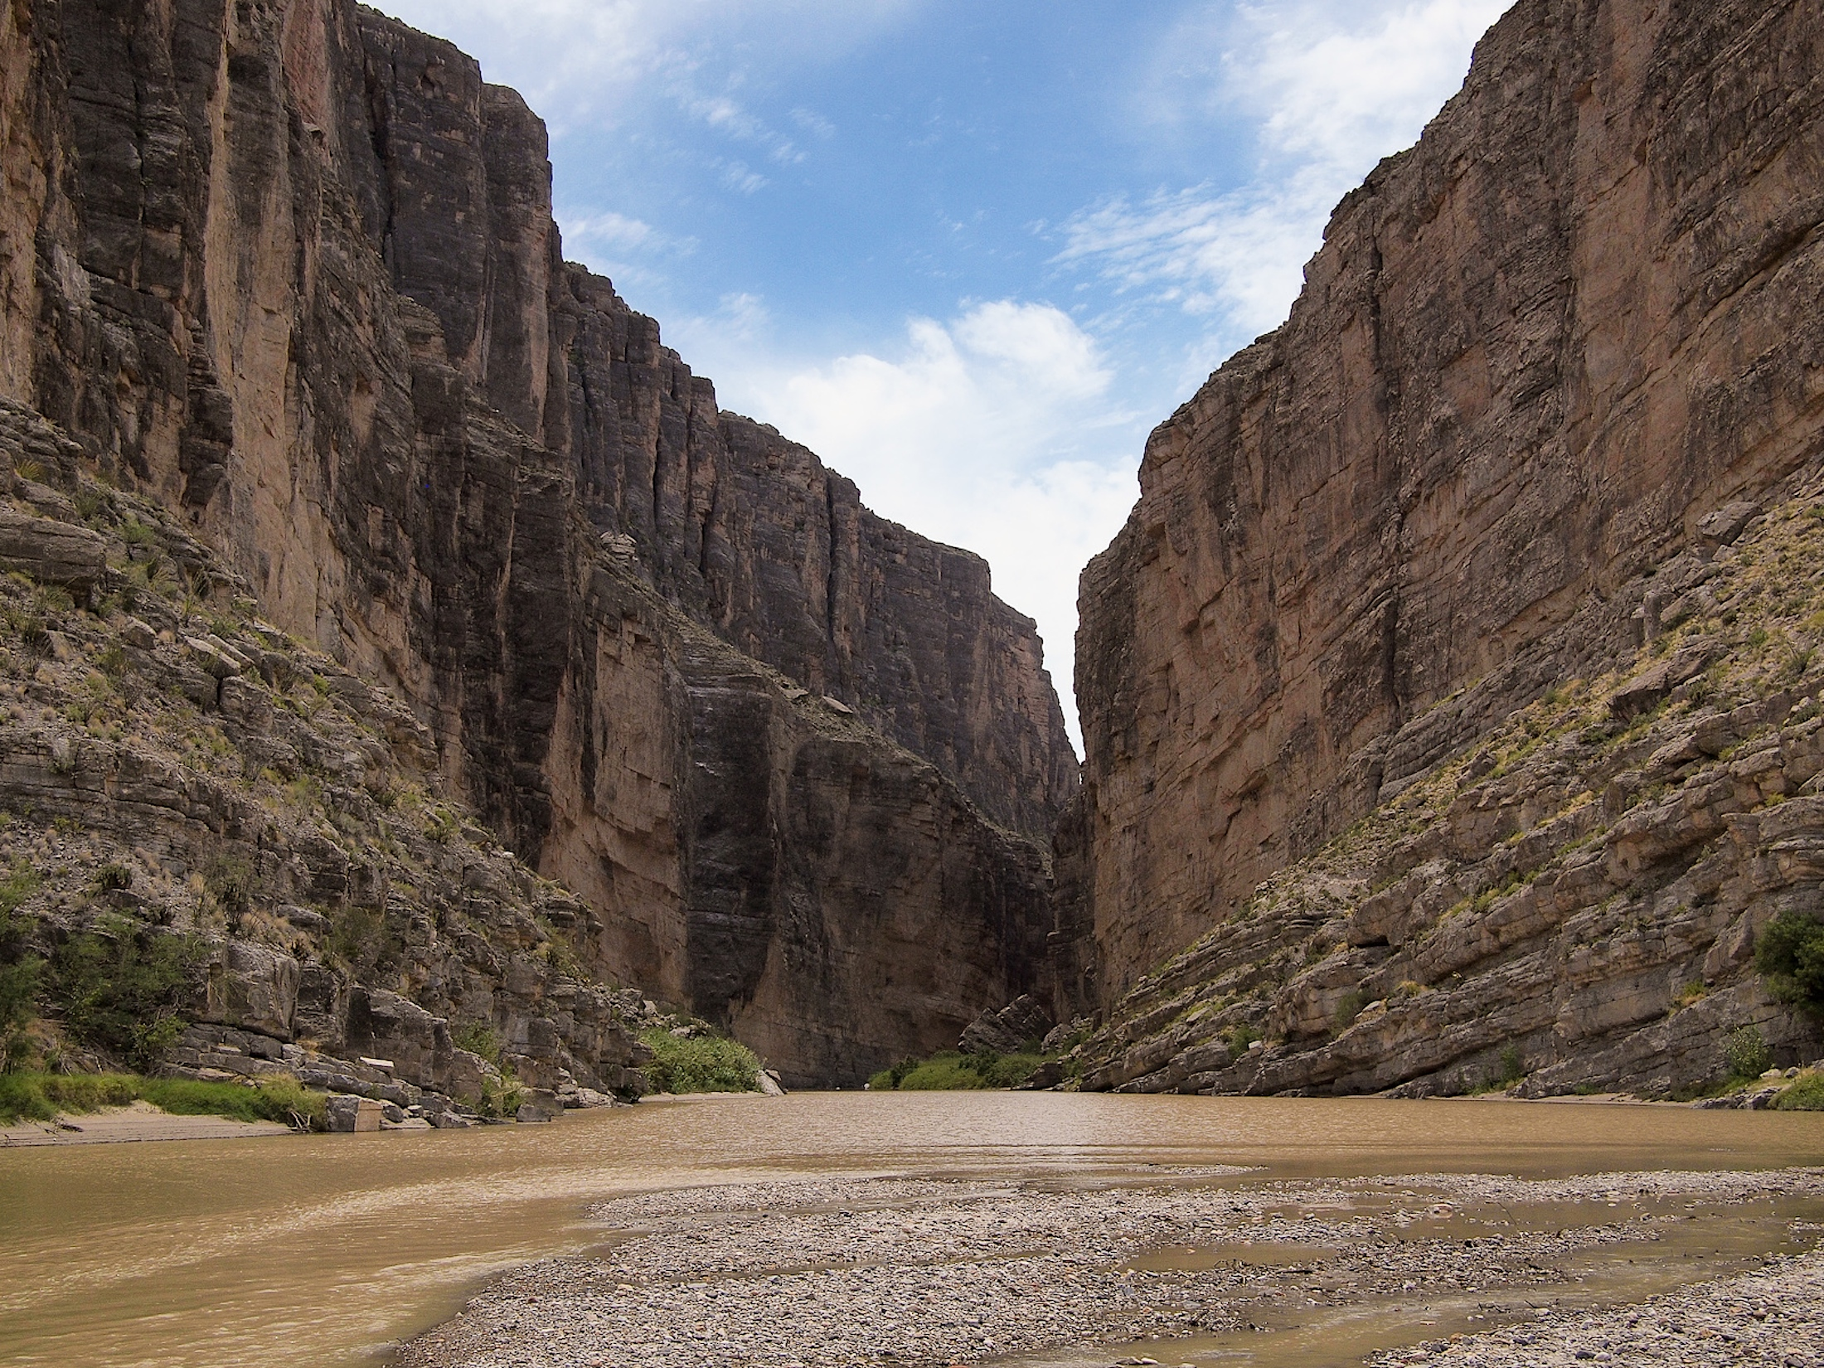
Never underestimate the power of a small group of committed people to change the world. In fact, it is the only thing that ever has.
Margaret Mead
American Anthropologist

Slide 36
Questions?
Kristi Mills-Jurach, P.E.
kristi.mills-Jurach@tceq.texas.gov
(512) 239-1261

